Slide 1
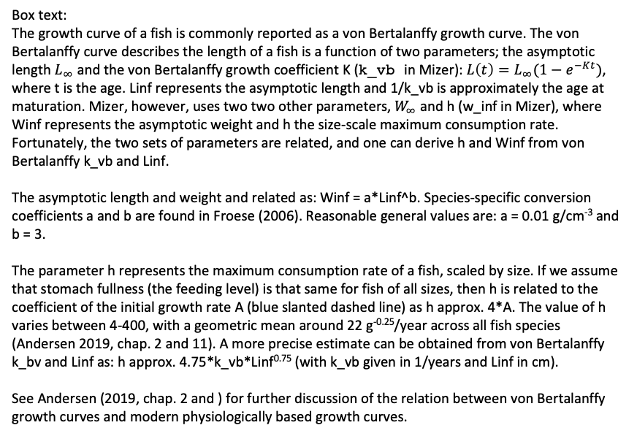
Weight
A*w^{0.75}
w_inf
w_mat
1/k_vb
Age
Box text:
The growth curve of a fish is commonly reported as a von Bertalanffy growth curve. The von Bertalanffy curve describes the length of a fish is a function of two parameters; the asymptotic length $L_{∞}$ and the von Bertalanffy growth coefficient K (k_vb in Mizer): $L\left(t\right)=L_{∞}(1−e^{−Kt})$, where t is the age. Linf represents the asymptotic length and 1/k_vb is approximately the age at maturation. Mizer, however, uses two two other parameters, $W_{∞}$ and h (w_inf in Mizer), where Winf represents the asymptotic weight and h the size-scale maximum consumption rate. Fortunately, the two sets of parameters are related, and one can derive h and Winf from von Bertalanffy k_vb and Linf.
The asymptotic length and weight and related as: Winf = a*Linf^b. Species-specific conversion coefficients a and b are found in Froese (2006). Reasonable general values are: a = 0.01 g/cm⁻³ and b = 3.
The parameter h represents the maximum consumption rate of a fish, scaled by size. If we assume that stomach fullness (the feeding level) is that same for fish of all sizes, then h is related to the coefficient of the initial growth rate A (blue slanted dashed line) as h approx. 4*A. The value of h varies between 4-400, with a geometric mean around 22 g^{-0.25}/year across all fish species (Andersen 2019, chap. 2 and 11). A more precise estimate can be obtained from von Bertalanffy k_bv and Linf as: h approx. 4.75*k_vb*Linf^{0.75} (with k_vb given in 1/years and Linf in cm).
See Andersen (2019, chap. 2 and ) for further discussion of the relation between von Bertalanffy growth curves and modern physiologically based growth curves.

